Slide 1

ELC Cognitive Demand
to Build Proof of Concept
February 2, 2017

Slide 2

iQOS: Track and Trace Objectives
Phillip Morris would like to track the iQoS device from its manufacturing through distribution and finally the consumer in order to prove provenance and traceability
In order to accomplish this the charger & holder will have to be tracked

Slide 3
Current Challenges
PMI has a access to the data currently. However the process presents challenges that a blockchain solution could overcome:
Increasing Trust and immutability during the process
Data retrieval across the supply chain is time consuming and manual.
End to End visibility is lacking
Recall

Slide 4
The End To End Process
Contract Agreement
(PMI & EMS)
Work Order Issued to the EMS
Procure Raw Material from PMl Approved vendors
Raw Material Receipt @ EMS
Charger Assembly
Quality checkpoints & verification
PMI & EMS agree to the contract
EMS procures raw material based on PMI contract with supplier
Packing Finished Goods
Ship To PMI DC
Receipt @ PMI DC
Ship to Distributor
Consumer Registration
Holder Assembly Assembly
EMS
PMI

Slide 5
Participants on the blockchain
Assembly line
Validating peer node
Validating peer node
Packaging line
Non Validating peer node
Shared ledger
Smart Contract
Quality Auditor
Non Validating peer node
Validating peer node
Regulator
Distributor

Slide 6
Objective of the PoC
The objective of the Proof of concept is to prove
Blockchain can provide visibility of data across the EMS provider and the distribution network
Demonstrate the ability to visualize traceability at the EMS manufacturer
Develop a business case to support the deployment on the application

Slide 7
The Proposed Use Case Definition
The usecase the PoC will focus on tracking the charger and its key components from the start of the assembly at the EMS facility to it being received at the PMI distribution center.
The usecase spans across the key constituents and capability which will ensure that the solution is scalable once proven

Slide 8
PoC: Process Steps and Data Sources
Process Step
Raw Material Receipt @ EMS
Start Charger Assembly
End Charger Assembly
Packing Finished Goods
Ship To PMI DC
Receipt @ PMI DC
Ship to Distributor
Data Source
File from EMS to identify Components for the Assembly ID
File from EMS to identify Components for the Assembly ID and
Charger S/N
File from EMS with Case ID
&
Charger S/N
Shipment Notification with Case ID + Ship To Details
PMI DC Receipt Case ID + Ship To Details
PMI DC Shipment Notification
Case ID + Ship To Details
Assembly ID
Component ID
Component Batch
Component Quality Check
Charger S/N
Assembly ID
Component ID
Component Batch
Component Quality Check
Case ID
Charger S/N
Date & Time
Packed By
BOL Number
Case ID
Date & Time
Carrier
Ship-To details
BOL Number
Case ID
Date & Time
BOL Number
Case ID
Date & Time
Carrier
Ship-To details
Key Data
EMS
PMI

Slide 9
The PoC will simulate the four participants in the Blockchain network
Validating peer node
Assembly line
Validating peer node
Packaging line
Data:
Component ID’s
Component Attributes
Batch ID’s
Charger S/N
UI
Data Input Via file
Activity Report
Data:
Charger S/N
Case ID
UI
Data Input Via file
Activity Report
Shared ledger
Smart Contract
Non Validating peer node
Data:
Goods Receipt Data
Goods Issue Data
UI
Data Input Via file
Activity Report
Validating peer node
Quality Auditor
UI
Activity Report
Distribution Center

Slide 10
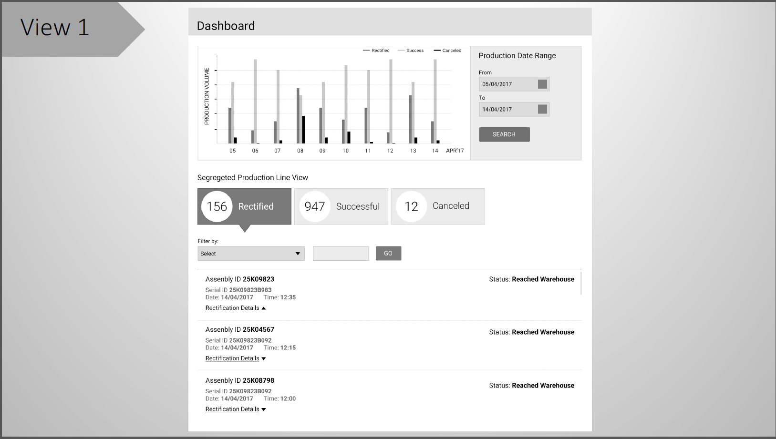
An intuitive and clear dashboard that provides visibility
An indicative dashboard view. To be refined and finalized during the design thinking workshop phase
A complete wireframe

Slide 11
How We’ll Do It
Week 1
Week 2
Week 3
Week 4
Week 5
Week 6
Week 7
Week 8
Week 9
Week 10
Steering Committee
Program Management
Data Consolidation
Sprint 1 : EMS Assembly & Visualization
Sprint : PMI DC and Visualization
Finalize
Environment Build
Iterative Build
Design Thinking
Checkpoint
LEGEND
Executive Checkpoint
Notes:
Overlap in phase 2 and 3 –
Phase 1 – team mobilization
Processs documentation
Intereviews, workshops, future state design
Zone location long list / short list

Slide 12
Key Activities and Deliverable
Data Prep & Staging
Sprint 1 : EMS Assembly
Sprint 2 : PMI DC and Visualization
Finalize
3 Week
3 Weeks
3 Weeks
1 Week
Program Management
On Going Project Management
Gather Data Files
Consolidate Data from various sources into temporary tools
Validate & Normalize Data
Establish Environment
Setup of DevOps - Continuous integration pipeline
Refine Smart contract design
Process Definition & Testing
Overall design definition for Smart Contracts(Chaincode)
Develop Smart Contracts
UI Build & Visualizations for complete end to end view for QA Auditor peer.
Build
Design Thinking Workshops
Develop Wireframes
Develop Smart Contracts and simple UI views for EMS, packaging line, DC – providing the ability to load data and write to Blockchain
Perform end to end workflow tests
Project plan
Harmonized data model
Low fidelity wireframes
High fidelity Wireframes
System Demo for EMS Assembly
Updated high fidelity Wireframes
System Demo for PMI DC
System Demo for end to end flow for traceability.
Final Sign-off
Business case
Deliverables

Slide 13
Financial Considerations

Slide 14
Key Assumptions
PMI will provide data and access to SME’s as required by the PoC
There are no system to system integrations in scope. Any data loaded to the block chain will be through manual files.
The Blockchain network will be hosted on Bluemix
The Blockchain writes from various systems will be simulated via a front end solution to be hosted on Bluemix

